Slide 1
CreditOne Problem
Shashank Tomar | C5T1

Slide 2
Data Science Framework Report should include the following:
A written statement of the goal(s)
A well-defined data science process framework and the reasons you are proposing it
Descriptions and location of related data sources
An explanation of how you will manage the data for the project
Any known issues with the data and how you plan to address them
A flowchart visualizing the detailed process you will follow, annotated with any potential pitfalls you’ve identified and your proposed solutions to such pitfalls.
Any initial insights you can glean from your quick look at the data. (Recall that you were previously ask to recommend three management-level decisions on the basis of your initial analysis.)

Slide 3
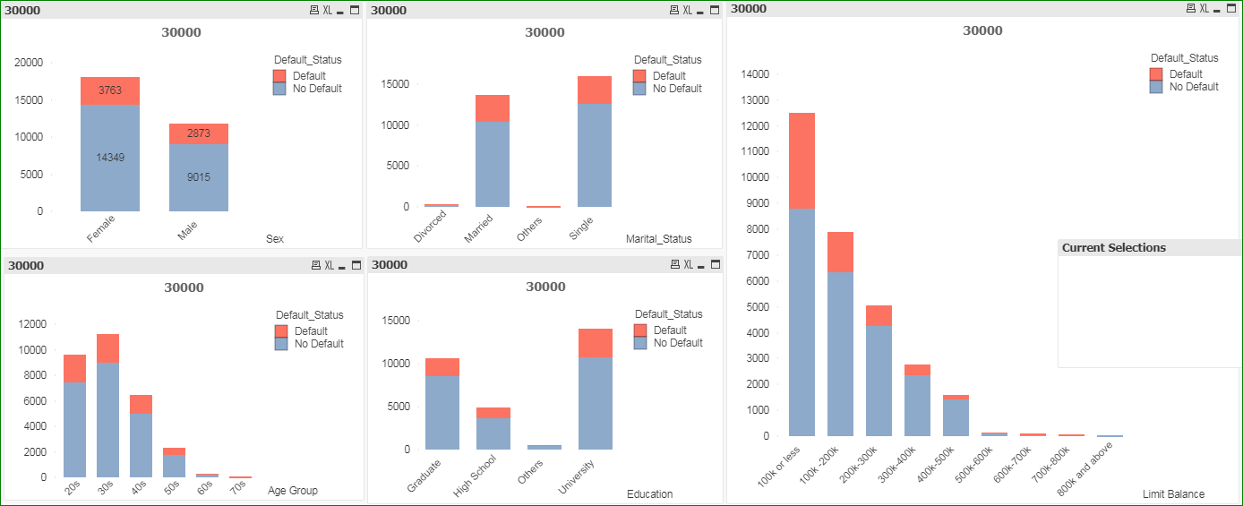
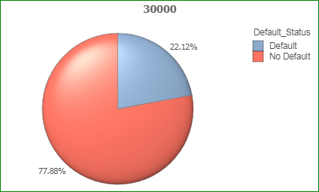
Goal: Develop predictive models to forecast loan defaults for Credit One
Credit One is experiencing a higher % ( 22%) of loan defaulting.
The % varies across various customer attributes like sex, age, marital status, education etc.
The goal is to use the data from 30000 customers regarding their demographics and payment history.

Slide 4
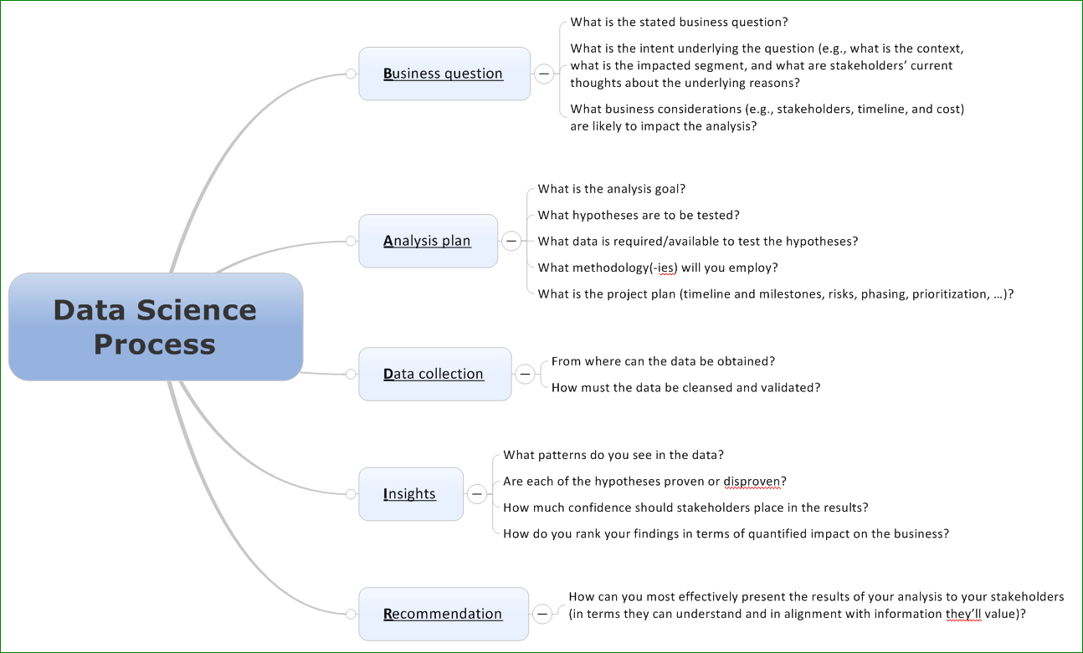
Data Science Process Framework

Slide 5
Descriptions and Location of Related Data Sources
The dataset provided by Credit One consists of the following attributes
Amount of given credit
Gender, Education, Marital status, Age
History of past payments
Amount of bill statement
Amount of previous payment
Did this customer default or not.

Slide 6
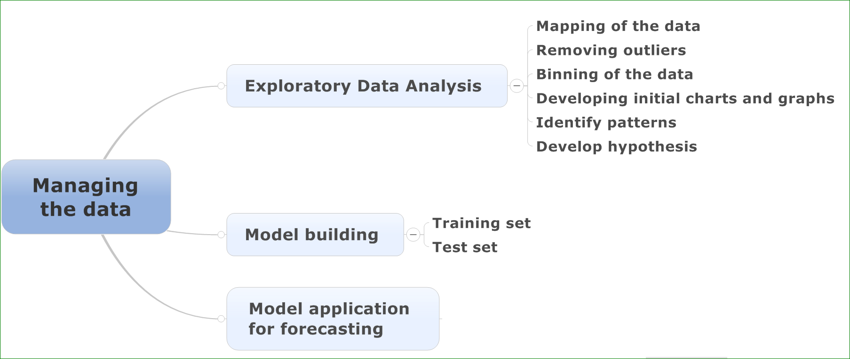
Explanation of How Will We Manage Dataset

Slide 7
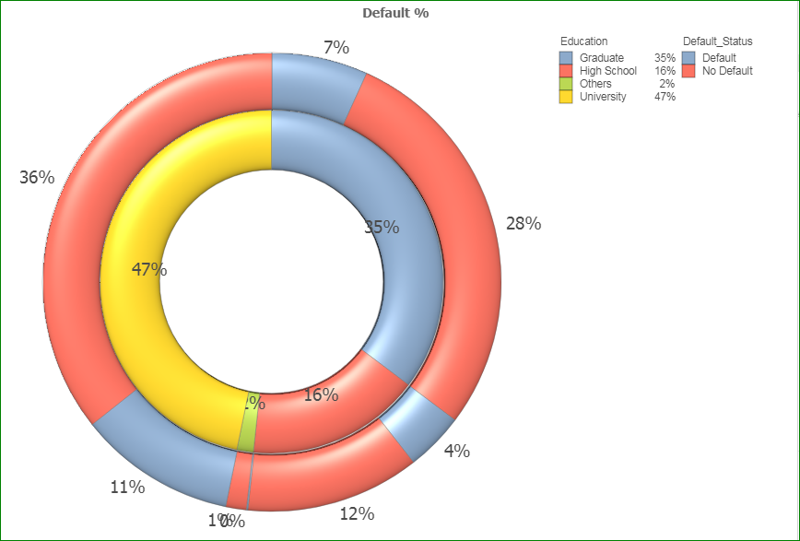
Initial Findings
Highest default 11% in university educated

Slide 8
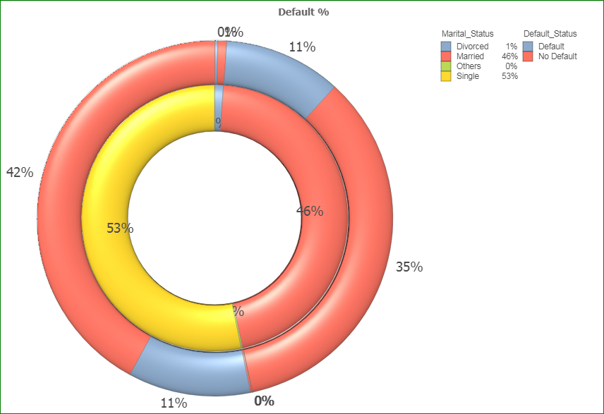
Initial findings
Married/single having similar default rates

Slide 9
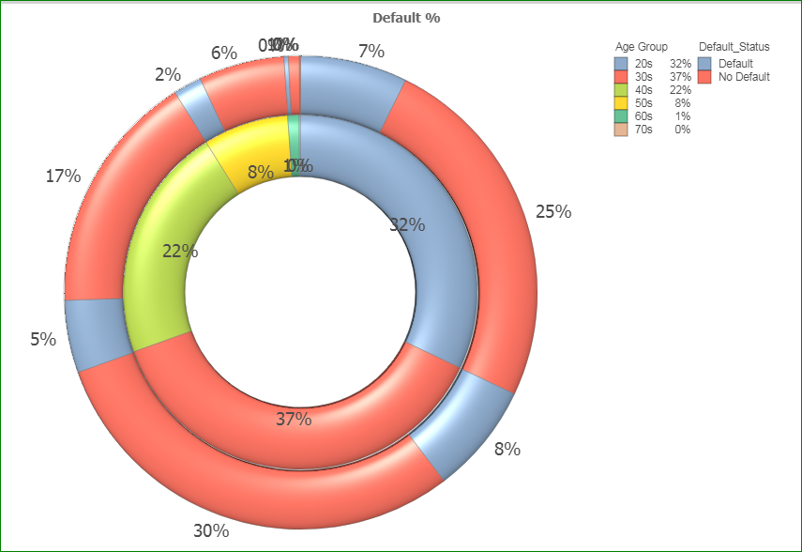
Initial findings
Younger age group 20s and 30s having similar default rates

Slide 10
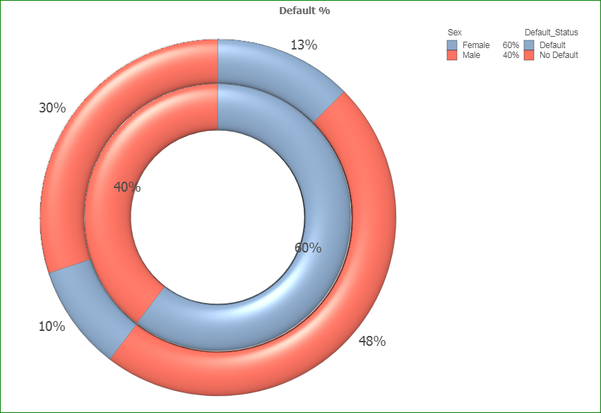
Initial findings
Female have higher default rates

Slide 11
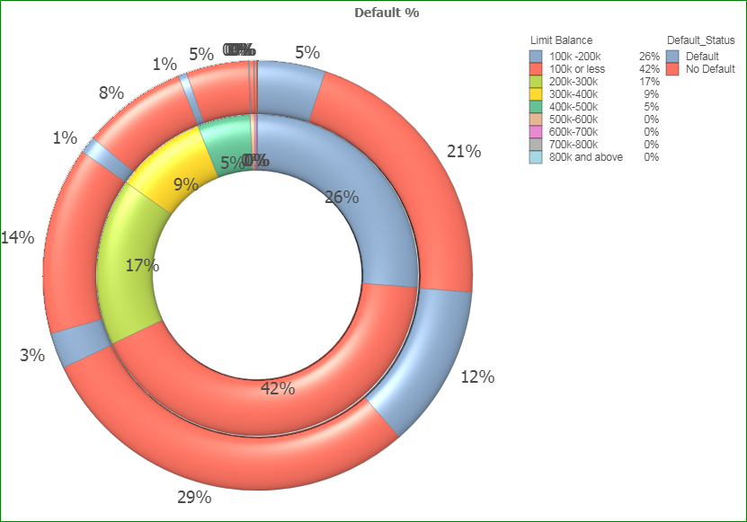
Initial findings
Highest default 12% in customer with limits 100k or less

Slide 12
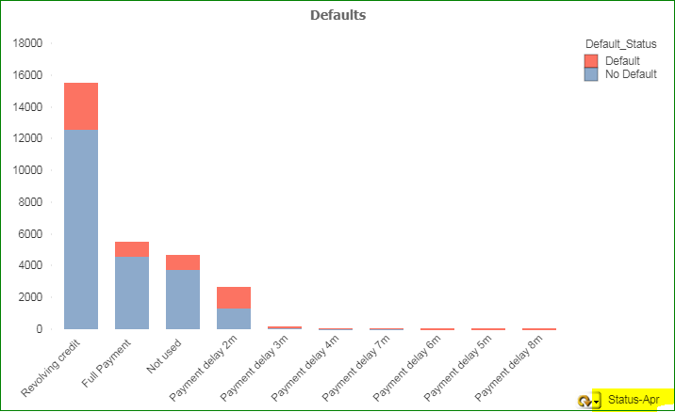
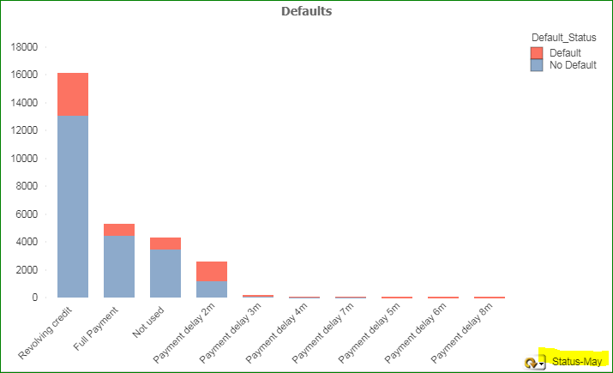

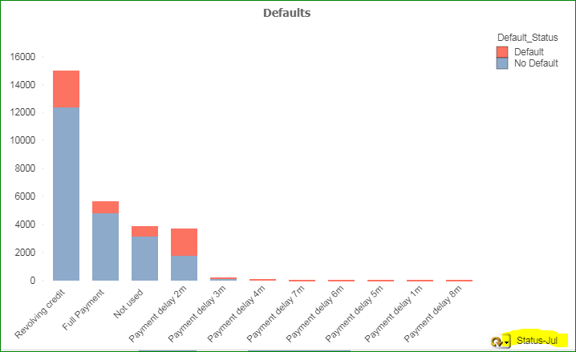
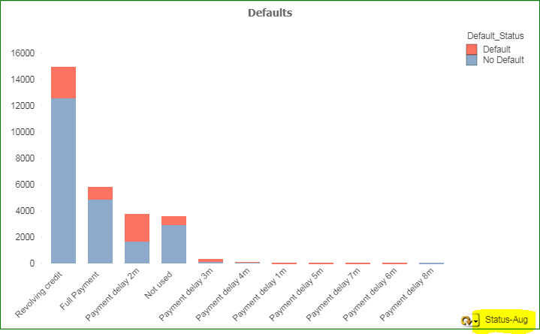
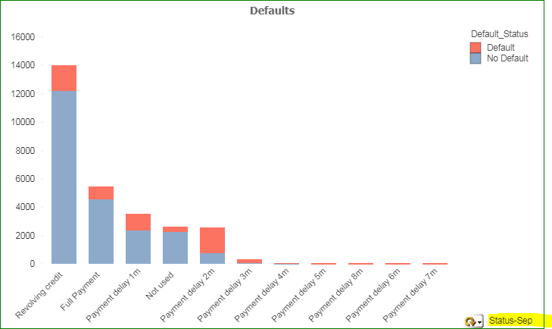
Delay of payments >2 almost 100% results in default
Highest default with revolving credit
Even those doing full payment default

Slide 13
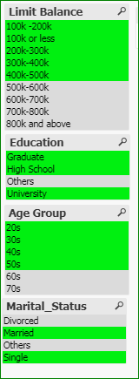
Data Exclusion
Based on % of data – plan to include only the one’s with green cells.
The data for grey groups is not helpful. This is about 5% of the data.
Other areas is handling negative numbers.

Slide 14
Flow chart for data exploration
Studying data in excel
Mapping/Binning the data for right descriptors
Visualizing the data
Identifying patterns
Identifying data not contributing and excluding
Performing EDA in Python

Slide 15
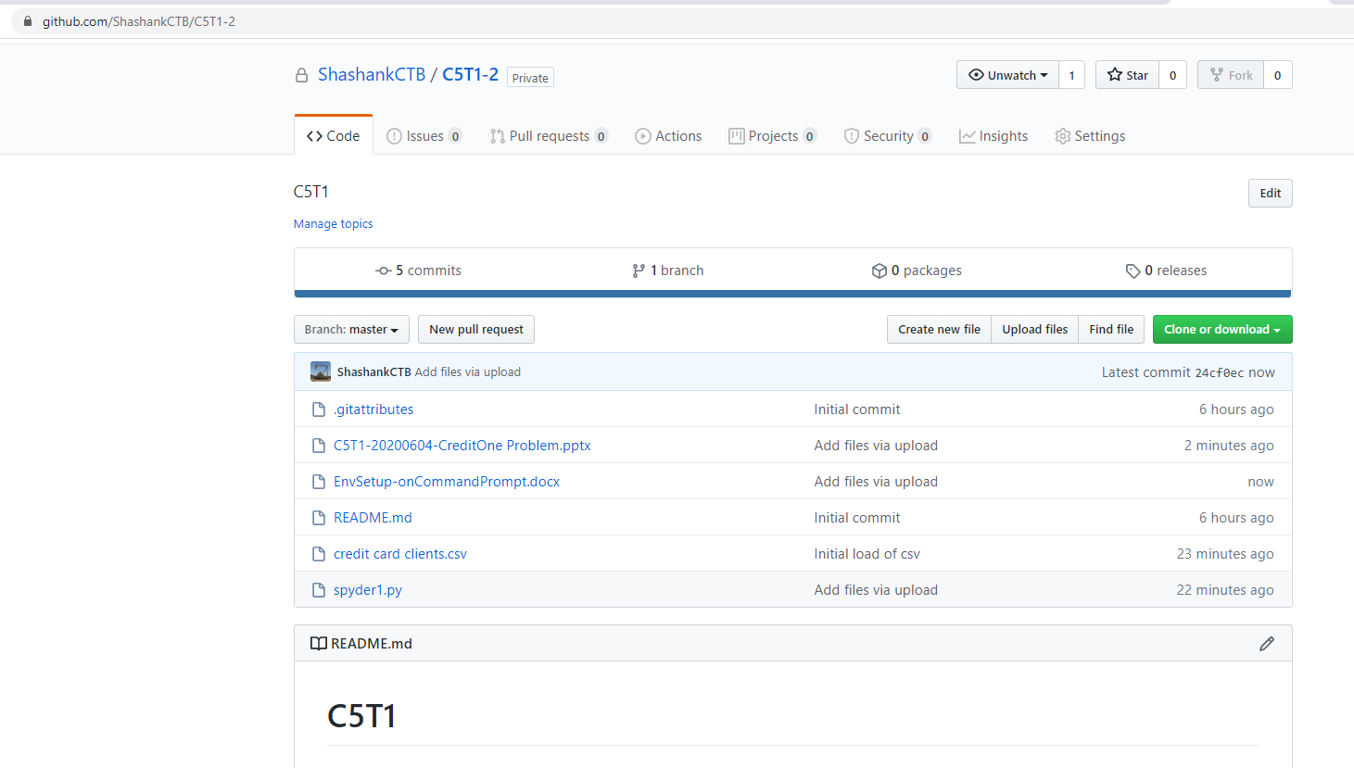
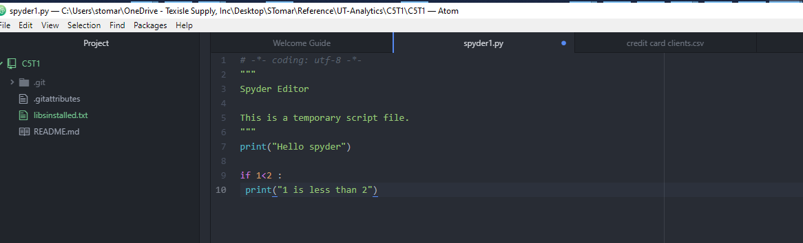
Github

Slide 16
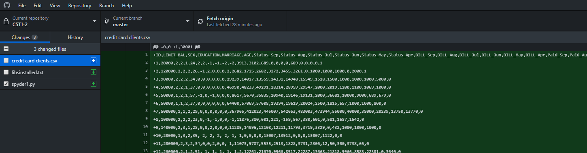
Github
Was it straightforward to install Python and all of the libraries? Yes
Was the tutorial useful? Would you recommend it to others? Yes
What are the main lessons you've learned from this experience? Follow the instructions by closely. Pay attention to syntax. Github is nothing but a repository to help manage versions of the code (rev control)

